Slide 1
Facade

Slide 2
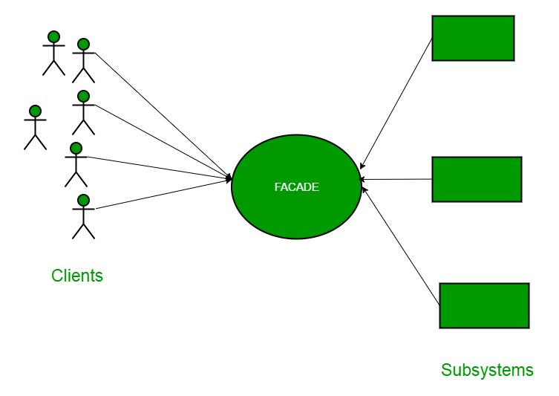
What is?
Facade is a structural design pattern that provides a simplified interface to a library, a framework, or any other complex set of classes.

